Slide 1

Advance Database Management System BCAE0001
Presented by:
Atul Kumar Uttam
Assistant Professor
Computer Engineering & Applications Department, GLA University, Mathura
atul.uttam@gla.ac.in, +91-8979593001

Slide 2
2. Lock Based Protocol
To adhere consistency, isolation is the most important idea.
Locking is the simplest idea to achieve isolation.
First obtain a lock on a data item
Then performed the desired operation and
Then Unlock it

Slide 3
To provide better concurrency along with isolation we use different modes of locks.
Shared Mode Lock
Exclusive Mode Lock

Slide 4
SHARED MODE
denoted by LOCK_S(Q)
Transaction can perform Read operation only,
any other transaction can also obtain the same lock on the same data item at the same time(So called shared)

Slide 5
Exclusive Mode
Denoted by LOCK_X(Q)
Transaction can performed READ/WRITE operations,
any other transaction can not obtained shared/exclusive mode lock.

Slide 6
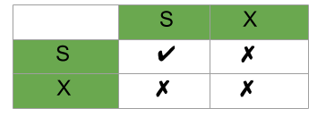
Lock Compatibility Matrix

Slide 7
Lock Compatibility
A transaction may be granted a lock on an item if the requested lock is compatible with locks already held on the item by other transactions.
Any number of transactions can hold shared locks on an item,
But if any transaction holds an exclusive(X) on the item no other transaction may hold any lock on the item.
If a lock cannot be granted, the requesting transaction is made to wait till all incompatible locks held by other transactions have been released. Then the lock is granted.

Slide 8
Schedule
T1 | T2
Lock_X(A)
R(A)
W(A)
Unlock(A)
 | Lock_S(B)
 | R(B)
 | Unlock(B)
Lock_X(B)
R(B)
W(B)
Unlock(B)
 | Lock_S(A)
 | R(A)
 | Unlock(A)

Slide 9
Deadlock – T₁ holds an Exclusive lock over B, T₂ holds a Shared lock over A. Consider Statement 7, T₂ requests for lock on B, while in Statement 8 T₁ requests lock on A. This as you may notice imposes a Deadlock as none can proceed with their execution.
Schedule
 | T₁ | T₂
1 | Lock_X(B)
2 | read(B)
3 | B:=B-50
4 | write(B)
5 |  | Lock_S(A)
6 |  | read(A)
7 |  | Lock_S(B)
8 | Lock_X(A)

Slide 10
Properties of lock based protocol
If we do unlocking inconsistency will occur,
If we allow lock then concurrency will be poor.
We require then transaction follow some set of rules for locking and unlocking of data item e.g. 2PL, and graph based.
We say a schedule is legal under a protocol if it can be generated using the rules of the protocols.
The protocol assures serializability.
It can be proved that the transactions can be serialized in the order of their lock points (i.e. the point where a transaction acquired its final lock).

Slide 11
Two-Phase Locking Protocol
This protocol requires that each transaction in a schedule will be two phased:
growing phase
shrinking phase.

Slide 12
Two-Phase Locking Protocol
In growing phase transaction can only obtain lock but can not release any lock.
In shrinking phase transaction can only release lock but can not obtain any lock.
Transaction perform read and write operation both in growing and shrinking phase.

Slide 13
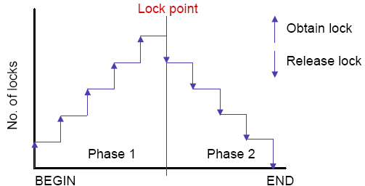
Two-Phase Locking Protocol …

Slide 14
Transaction T₁: Growing Phase is from steps 1-3. Shrinking Phase is from steps 5-7. Lock Point at 3 Transaction T₂: Growing Phase is from steps 2-6. Shrinking Phase is from steps 8-9. Lock Point at 6
Two-Phase Locking Protocol
 | T₁ | T₂
1 | LOCK-S(A)
2 |  | LOCK-S(A)
3 | LOCK-X(B)
4 | ……. | ……
5 | UNLOCK(A)
6 |  | LOCK-X(C)
7 | UNLOCK(B)
8 |  | UNLOCK(A)
9 |  | UNLOCK(C)

Slide 15
Property 1. Ensure CS/VS, the order of the serializability is the order in which transaction reaches lock point.
Schedule S
----------------------
T1 T2 T3 T4
Suppose if T2 reaches its lock point first then T3, after that T1 and finally T4, then the order of serializability is……..?
T2->T3->T1->T4

Slide 16
Property 2. Do not ensure freedom from deadlock.
T1 | T2
Lock_S(A)
Read(A)
 | Lock_X(B)
 | Read(B)
 | Write(B)
Lock_S(B)
 | Lock_X(A)

Slide 17
Property 3. May generate Irrecoverable schedule
T1 | T2
Lock_X(A)
R(A)
W(A)
Unlock(A)
 | Lock_S(A)
 | R(A)
 | Unlock(A)
 | Commit
Commit

Slide 18
Property 4. May generate cascading rollback
T1 | T2
Lock_X(A)
R(A)
W(A)
Unlock(A)
 | Lock_S(A)
 | R(A)
 | Unlock(A)
Commit
 | Commit

Slide 19
a. Conservative/Static 2 PL
There is no growing phase
Transaction first will acquire all the locks required before any operation, and then directly will start from lock point.
If all the locks are not available then transaction must release the lock acquired so far and wait.
Shrinking phase works as usual and transaction can unlock any data item.
Here we must have all the knowledge that what data items will required during execution.

Slide 20
CS & VS and deadlock free
Possibility of irrecoverable schedules and cascading rollback.
Lock Point
Shrinking Phase

Slide 21
Imp Note
If there is dirty read then cascading rollback
If there is no rule for commit then irrecoverable schedule,
T1 T2
Lock_X(A)
R(A)
W(A)
Unlock(A)
Lock_S(A) R(A) Commit
Commit

Slide 22
b. Rigorous 2PL
It is an improvement over 2PL protocol where we try to ensure Recoverability and cascadelessnes.
Rigorous 2PL requires that all the lock must be held until transaction commits,
i.e. there is no shrinking phase.
Will ensure CS/ VS , recoverability, cascadelessness.
Suffers from deadlock and inefficiency.
Lock Point
Growing Phase

Slide 23
Conservative 2PL
Rigorous 2PL
T1 T2
Lock_X(A)
R(A)
W(A)
Unlock(A)
Lock_S(A) R(A) Commit
Commit
T1 T2
Lock_X(A)
R(A)
W(A)
Commit
Lock_S(A) R(A) Commit

Slide 24
c. Strict 2PL
It is an improvement of Rigorous 2PL.
In the shrinking phase unlocking of Exclusive_lock are not allowed but unlocking of Shared_lock can be done.
All the properties are the same as Rigorous 2PL, but it provides better concurrency.
Lock Point
Growing Phase
Shrinking Phase

Slide 25
3. Graph based Protocol
If we wish to develop lock based protocol that are not 2PL we need additional info that how each transaction will access the data.
There are various model that can give additional information, each differing in the amount of the information provided.
One idea is to have prior knowledge about the order in which the data item will be accessed.

Slide 26
We impose Partial Ordering on set of all data item D = {d1,d2, d3, ……..dn}.
If di -> dj, then any transaction accessing both di and dj must access di before dj.
P.O. may be because logical or physical organization or only because of concurrency control.

Slide 27
After P.O. set, all data item D will now be viewed as directed acyclic graph called database graph.
We follow two restrictions:
Will study graph that are rooted tree.
Will use only exclusive mode lock only.

Slide 28
Tree based Protocol
Each transaction Ti can lock a data item Q with following rules:
First lock of Ti may be on any data item.
Subsequently, a data item Q can be locked by Ti only if the parent of Q is currently locked by Ti.
Data item may be unlocked at any time
Data item Q that has been locked and unlocked by Ti can not Subsequently be relocked by Ti.

Slide 29
A
T1 | T2
Lock_X(B) | Lock_X(A)
Lock_X(D) | Lock_X(B)
Lock_X(E) | Lock(_XC)
Unlock(B) | Unlock(A)
Lock_X(I) | Lock_X(D)
Unlock(D) | Unlock(B)
Unlock(E) | Lock_X(G)
Unlock(I) | Unlock(D)
 | Unlock(G)
 | Unlock(C)
B
C
D
F
E
G
I
H
J

Slide 30
Properties of Tree Based Protocol
All schedules that are legal under the tree protocol are CS and VS.
Freedom from deadlock
Do not ensure recoverability and cascadelessness
Early locking is possible, which leads shortest waiting time, an increase concurrency.

Slide 31
A transaction may have to lock data item that it does not access, lead to overhead.
Increased waiting time and decrease in concurrency.
Transaction must know exactly what data items are to be accessed.
Recoverability and cascadelessness can be provided by not unlocking before commit.

Slide 32
Summary
 | Dead Lock | Irrecoverable Schedule | Cascading Rollback | Other
2PL | Yes | Yes | Yes | CS/VS
Conservative 2PL | NO | Yes | Yes | No Growing Phase
Rigorous 2PL | Yes | No | No | No Shrinking Phase
Strict 2PL | Yes | No | No | Improved Concurrency, In Shrinking Phase release only Shared Lock
Graph Based Protocol | No | Yes | Yes | Prior Knowledge about data item required by Transaction
Time Stamping | No | Yes | Yes

Slide 33
Q&A
Q1. Which of the following concurrency control protocols ensure both conflict serialzability and freedom from deadlock?
I. 2-phase locking
II. Time-stamp ordering
(A) I only
(B) II only
(C) Both I and II
(D) Neither I nor II

Slide 34
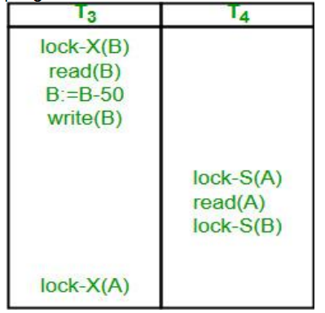
Answer: (B)

Slide 35
Q2. Consider the following schedule for transactions T1, T2 and T3:
Which one of the schedules below is the correct serialization of the above?
(A) T1->>T3->>T2
(B) T2->>T1->>T3
(C) T2->>T3->>T1
(D) T3->>T1->>T2

Slide 36
Answer: (A)
T2
T1
T3

Slide 37
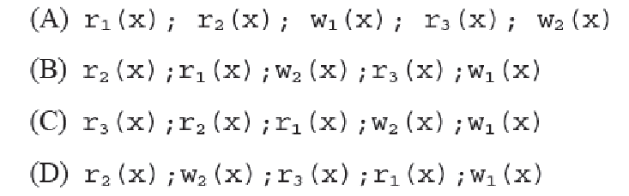
Q3 Consider the following four schedules due to three transactions (indicated by the subscript) using read and write on a data item x, denoted by r(x) and w(x) respectively.
Which one of them is conflict serializable.

Slide 38
Answer: (D)
Explanation: In option D, there is no interleaving of operations. The option D has first
all operations of transaction 2, then 3 and finally 1 There can not be any conflict as it is
a serial schedule with sequence 2 –> 3 — > 1

Slide 39
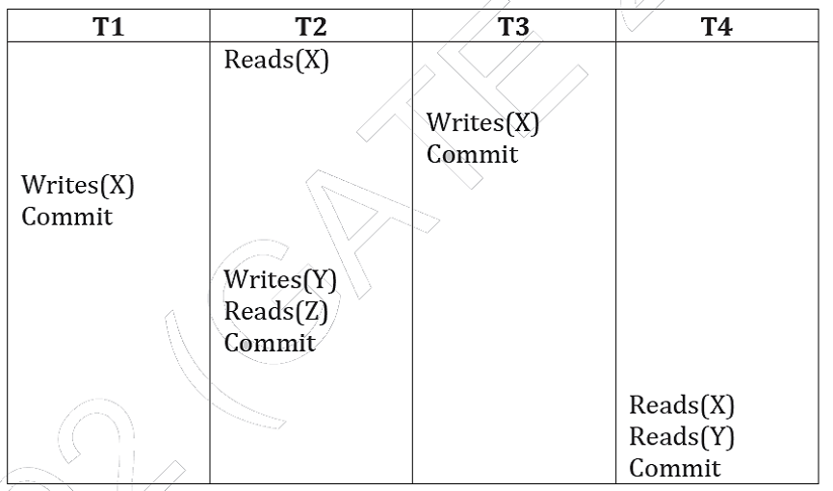
Q5.Consider the following schedule S of transactions T1, T2, T3, T4:

Slide 40
Which one of the following statements is CORRECT?
(A) S is conflict-serializable but not recoverable
(B) S is not conflict-serializable but is recoverable
(C) S is both conflict-serializable and recoverable
(D) S is neither conflict-serializable nor is it recoverable

Slide 41
Answer: (C)
Here, for the precedence graph there will be only two directed edges, one from T2 -> T3 ( Read- Write Conflict), and another from T2 -> T1( Read- Write Conflict), hence no cycle, so the schedule is conflict serializable.
Here no dirty read operation ( as T3 and T1 commits before T4 reads the Write(X) of T3
and T1 , and T2 commits before T4 reads the Write(Y) of T2 ). Therefore the schedule is recoverable.

Slide 42
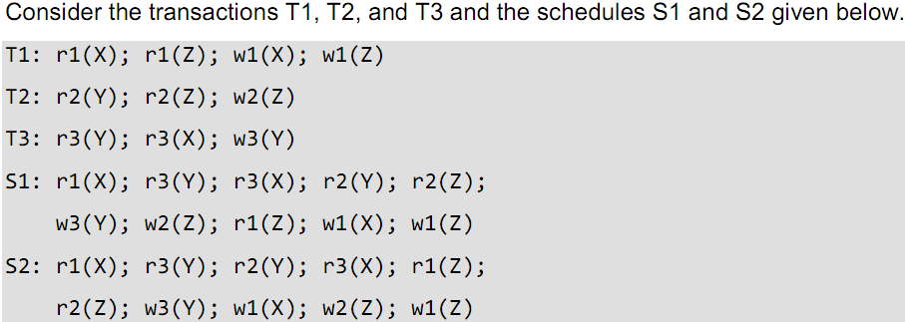
Which one of the following statements about the schedules is TRUE?
(A) Only S1 is conflict-serializable.
(B) Only S2 is conflict-serializable.
(C) Both S1 and S2 are conflict-serializable.
(D) Neither S1 nor S2 is conflict-serializable.

Slide 43
Answer: (A)
If we make a precedence graph for S1 and S2 , we would get directed edges
for S1 as T2->T1, T2->T3, T3->T1, and
for S2 as T2->T1, T2->T3, T3->T1, T1->T2.
In S1 there is no cycle,
but S2 has a cycle.
Hence only S1 is conflict serializable.
Note : The serial order for S1 is T2 -> T3 -> T1.

Slide 44
Q9. Which of the following scenarios may lead to an irrecoverable error in a database system ?
(A) A transaction writes a data item after it is read by an uncommitted transaction
(B) A transaction reads a data item after it is read by an uncommitted transaction
(C) A transaction reads a data item after it is written by a committed transaction
(D) A transaction reads a data item after it is written by an uncommitted transaction

Slide 45
Answer: (D)

Slide 46
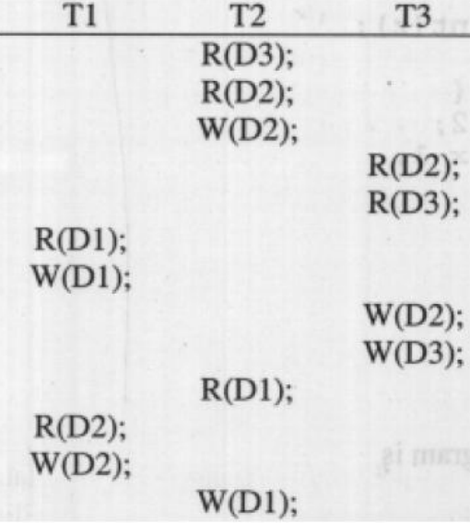
Which of the following statements is correct?
(A) The schedule is serializable as T2; T3; T1
(B) The schedule is serializable as T2; T1; T3
(C) The schedule is serializable as T3; T2; T1
(D) The schedule is not serializable

Slide 47
Answer: (D)
Explanation:
T1 and T2 have conflicting operations between them forming a cycle in the precedence graph.

Slide 48
Q17. Consider the following two phase locking protocol. Suppose a transaction T accesses (for read or write operations), a certain set of objects {O1,…,Ok}. This is done in the following manner:
Step 1. T acquires exclusive locks to O1, . . . , Ok in increasing order of their addresses.
Step 2. The required operations are performed.
Step 3. All locks are released.
This protocol will
(A) guarantee serializability and deadlock-freedom
(B) guarantee neither serializability nor deadlock-freedom
(C) guarantee serializability but not deadlock-freedom
(D) guarantee deadlock-freedom but not serializability

Slide 49
Answer: (A)
Explanation: The above scenario is Conservative 2PL( or Static 2PL). In Conservative 2PL protocol, a transaction has to lock all the items it access before the transaction begins execution. It is used to avoid deadlocks.
Also, 2PL is conflict serializable, therefore it guarantees serializability.

